Slide 1
Design Patterns State Design Pattern Chain of Responsibilities

Slide 2
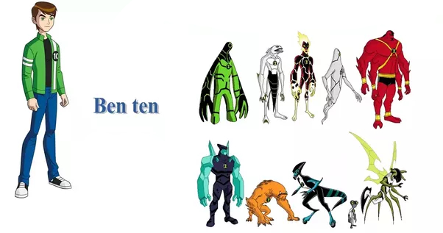
State Design Pattern (Behavioral)
Intent: The state pattern is used to alter the behavior of an object as its internal state changes. The pattern allows the class for an object to apparently change at run-time.

Slide 3
State Design Pattern (Behavioral)
Used to alter the behavior of an object as its internal state changes.
Allows object to change at run-time without changing the interface used to access the object or losing the current state.
The class change is hidden to the outside world with the use of a wrapper object, or context.
Useful when creating object oriented state machine

Slide 4
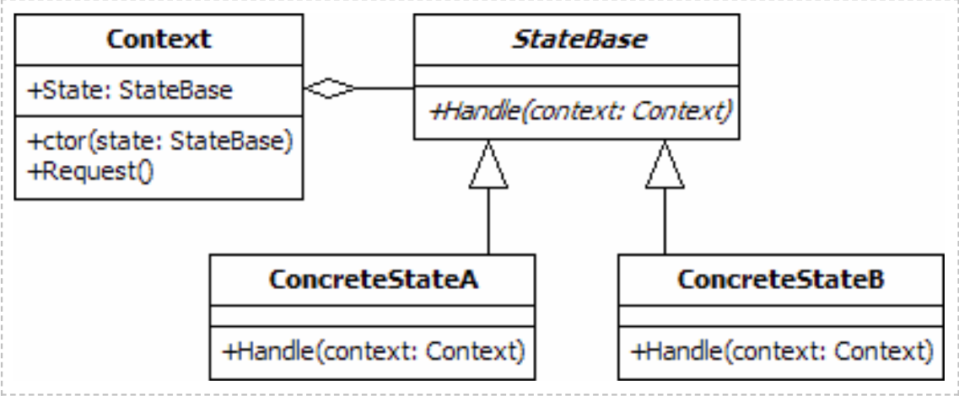
Implementation
Context:
Used by clients of the state design pattern
Clients do not access the state objects
directly.
It maintains references to concrete state
object which may be used to define
current state of object.
State Base:
It is an abstract class.
It is the base class for all concrete state classes.
It defines the interface that will be used by the Context
object to access the changeable functionality.

Slide 5
Implementation
Concrete State A/B:
provide the real functionality that will be
used by the context object.
Each state class provides behavior that is
applicable to a single state of the context
object.
They may also include instructions that
cause the context to change its state.

Slide 6
Code
public class Context { private StateBase _state; public Context(StateBase state) { _state = state; } public void Request() { _state.Handle(this); } public StateBase State { get { return _state; } set { _state = value; } } } public abstract class StateBase { public abstract void Handle(Context context); }
public class ConcreteStateA : StateBase { public override void Handle(Context context) { Console.WriteLine("Handle called from ConcreteStateA"); context.State = new ConcreteStateB(); } } public class ConcreteStateB : StateBase { public override void Handle(Context context) { Console.WriteLine("Handle called from ConcreteStateB"); context.State = new ConcreteStateA(); } }

Slide 7

Example: Media Player
State | Play Button | Audio Source Button
Standby | No effect. | Switch state to "MP3 Playing".
MP3 Playing | Stop music, switch state to "MP3 Paused". | Switch state to "Radio".
MP3 Paused | Start music, switch state to "MP3 Playing". | Switch state to "Radio".
Radio | Tune next radio station. | Switch state to "Standby".

Slide 8
public abstract class AudioPlayerState
{
public abstract void PressPlay(AudioPlayer player);
public abstract void PressAudioSource(AudioPlayer player);
}
public class StandbyState : AudioPlayerState
{
public StandbyState()
{
Console.WriteLine("STANDBY");
}
public override void PressPlay(AudioPlayer player)
{
Console.WriteLine("Play pressed: No effect");
}
public override void PressAudioSource(AudioPlayer player)
{
player.CurrentState = new MP3PlayingState();
}
}
public class AudioPlayer
{
private AudioPlayerState _state;
public AudioPlayer(AudioPlayerState state)
{
_state = state;
}
public void PressPlay()
{
_state.PressPlay(this);
}
public void PressAudioSource()
{
_state.PressAudioSource(this);
}
public AudioPlayerState CurrentState
{
get { return _state; }
set { _state = value; }
}
}

Slide 9
public class MP3PausedState : AudioPlayerState
{
public MP3PausedState()
{
Console.WriteLine("MP3 PAUSED");
}
public override void PressPlay(AudioPlayer player)
{
player.CurrentState = new MP3PlayingState();
}
public override void PressAudioSource(AudioPlayer player)
{
player.CurrentState = new RadioState();
}
}
public class RadioState : AudioPlayerState
{
public RadioState()
{
Console.WriteLine("RADIO");
}
public override void PressPlay(AudioPlayer player)
{
Console.WriteLine("Play pressed: New station selected");
}
public override void PressAudioSource(AudioPlayer player)
{
player.CurrentState = new StandbyState();
}
}
public class MP3PlayingState : AudioPlayerState
{
public MP3PlayingState()
{
Console.WriteLine("MP3 PLAYING");
}
public override void PressPlay(AudioPlayer player)
{
player.CurrentState = new MP3PausedState();
}
public override void PressAudioSource(AudioPlayer player)
{
player.CurrentState = new RadioState();
}
}

Slide 10
State Design Advantages & Disadvantages
Advantages:
With State pattern, the benefits of implementing polymorphic behavior are evident, and it is also easier to add states to support additional behavior.
In the State design pattern, an object’s behavior is the result of the function of its state, and the behavior gets changed at runtime depending on the state. This removes the dependency on the if/else or switch/case conditional logic. For example, in the TV remote scenario, we could have also implemented the behavior by simply writing one class and method that will ask for a parameter and perform an action (switch the TV on/off) with an if/else block.
The State design pattern also improves Cohesion since state-specific behaviors are aggregated into the ConcreteState classes, which are placed in one location in the code.
Disadvantages:
The State design pattern can be used when we need to change state of object at runtime by inputting in it different subclasses of some State base class. This circumstance is advantage and disadvantage in the same time, because we have a clear separate State classes with some logic and from the other hand the number of classes grows up.

Slide 11
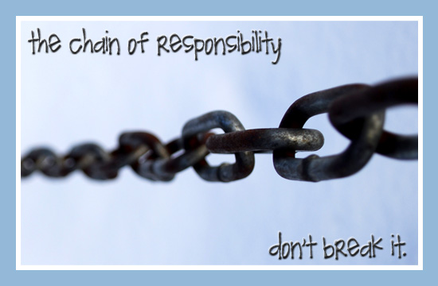
Chain Of Responsibility Design Pattern (Behavioral)
Intent: The chain of responsibility pattern is used to process varied requests, each of which may be dealt with by a different handler.

Slide 12
Chain Of Responsibility Design Pattern (Behavioral)
The chain of responsibility pattern is used to process varied requests, each of which may be dealt with by a different handler.
The design pattern promotes loose coupling by allowing a series of handlers to be created in a linked list or chain.
The request is passed to the first handler in the chain, which will either process it or pass it on to its successor. This continues until the request is processed or the end of the chain is reached.
The handler responsible for the final processing of the request need not be known beforehand.
This style of processing is used by the exception handling system in C#.

Slide 13
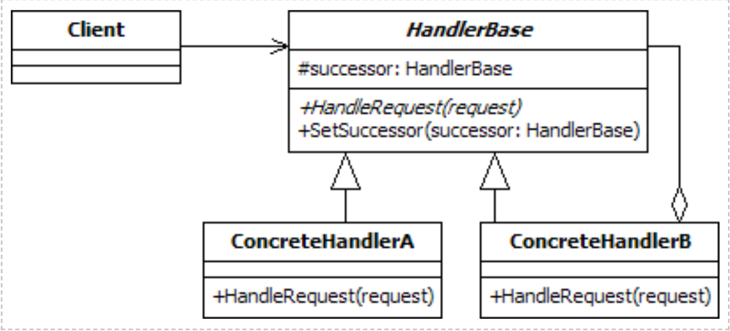
Implementation
Context:
The client is the class that generates the request and passes it to the first handler in the chain of responsibility.
Handler Base:
It is an abstract class.
It contains a member that holds the next
handler in the chain and an associated
method to set this successor.
It also includes an abstract method that must
be implemented by classes that inherit from it.
The implementations of this method must either handle the request or pass it to the next object in the pipeline.

Slide 14
Implementation
Concrete Handler:
The concrete handlers each inherit from
HandlerBase.
They include the functionality to handle some
requests and pass others to the next item in the
chain, should there be one.

Slide 15
Code
public abstract class HandlerBase { protected HandlerBase _successor; public abstract void HandleRequest(int request); public void SetSuccessor(HandlerBase successor) { _successor = successor; } } public class ConcreteHandlerA : HandlerBase { public override void HandleRequest(int request) { if (request == 1) Console.WriteLine("Handled by ConcreteHandlerA"); else if (_successor != null) _successor.HandleRequest(request); } }
public class ConcreteHandlerB : HandlerBase { public override void HandleRequest(int request) { if (request > 10) Console.WriteLine("Handled by ConcreteHandlerB"); else if (_successor != null) _successor.HandleRequest(request); } }

Slide 16
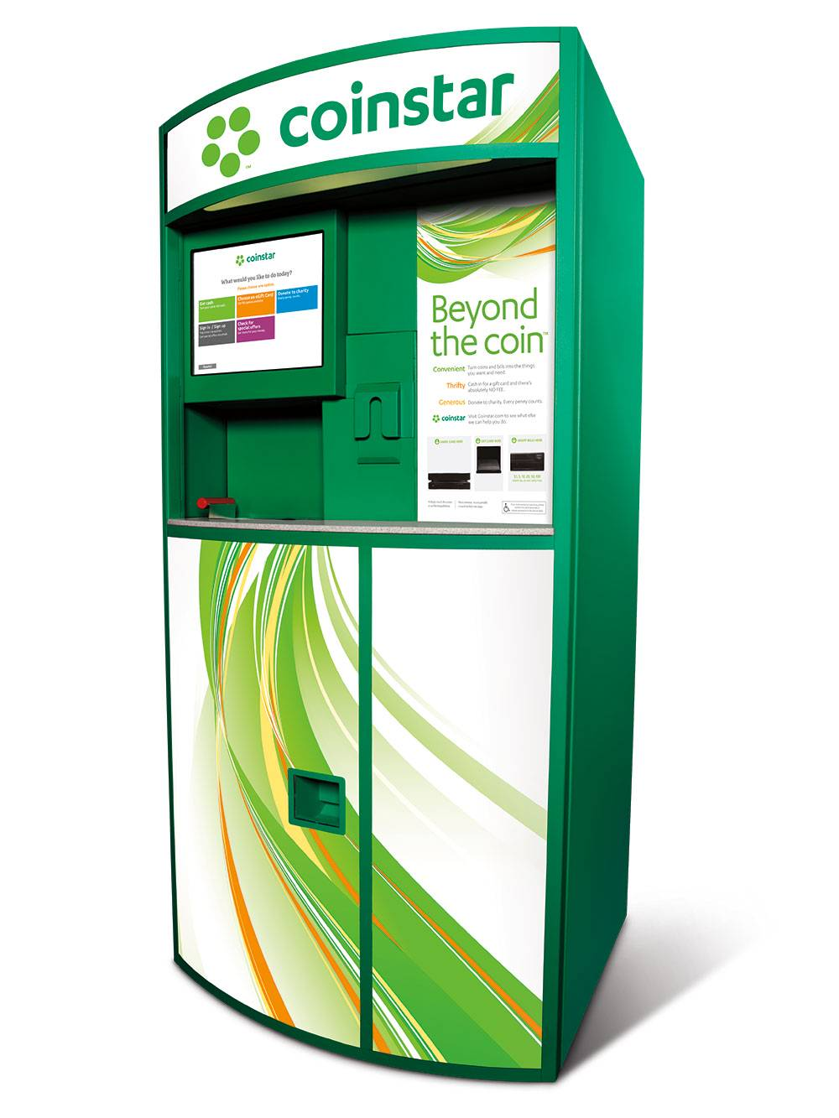
Example: Coin Handling System
The request will be a Coin object with a weight in grams and
diameter in millimeters.
We can create the coin class using the code below.
public class Coin
{
public float Weight {get; set;}
public float Diameter {get; set;}
}

Slide 17
public abstract class CoinHandlerBase
{
protected CoinHandlerBase _successor;
public abstract void HandleCoin(Coin coin);
public void SetSuccessor(CoinHandlerBase successor)
{
_successor = successor;
}
}
public class TwentyPenceHandler : CoinHandlerBase
{
public override void HandleCoin(Coin coin)
{
if (Math.Abs(coin.Weight - 5) < 0.01 && Math.Abs(coin.Diameter - 21.4) < 0.1)
Console.WriteLine("Captured 20p");
else if (_successor != null)
_successor.HandleCoin(coin);
}
}
public class FiftyPenceHandler : CoinHandlerBase
{
public override void HandleCoin(Coin coin)
{
if (Math.Abs(coin.Weight - 8) < 0.02 && Math.Abs(coin.Diameter - 27.3) < 0.15)
Console.WriteLine("Captured 50p");
else if (_successor != null)
_successor.HandleCoin(coin);
}
}
public class OnePoundHandler : CoinHandlerBase
{
public override void HandleCoin(Coin coin)
{
if (Math.Abs(coin.Weight - 9.5) < 0.02 && Math.Abs(coin.Diameter - 22.5) < 0.13)
Console.WriteLine("Captured £1");
else if (_successor != null)
_successor.HandleCoin(coin);
}
}
public class FivePenceHandler : CoinHandlerBase
{
public override void HandleCoin(Coin coin)
{
if (Math.Abs(coin.Weight - 3.25) < 0.02 && Math.Abs(coin.Diameter - 18) < 0.1)
Console.WriteLine("Captured 5p");
else if (_successor != null)
_successor.HandleCoin(coin);
}
}
public class TenPenceHandler : CoinHandlerBase
{
public override void HandleCoin(Coin coin)
{
if (Math.Abs(coin.Weight - 6.5) < 0.03 && Math.Abs(coin.Diameter - 24.5) < 0.15)
Console.WriteLine("Captured 10p");
else if (_successor != null)
_successor.HandleCoin(coin);
}
}

Slide 18
Chain Of Responsibility Advantages & Disadvantages
Advantages:
To reduce the coupling degree. Decoupling it will request the sender and receiver.
Simplified object. The object does not need to know the chain structure.
Enhance flexibility of object assigned duties. By changing the members within the chain or change their order, allow dynamic adding or deleting responsibility.
Increase the request processing new class of very convenient.
Disadvantages:
The request must be received not guarantee.
The performance of the system will be affected, but also in the code debugging is not easy may cause cycle call.
It may not be easy to observe the characteristics of operation, due to debug.

Slide 19
Chain Of Responsibility When & Where?
Where and When Chain of Responsibility pattern is applicable :
When you want to decouple a request’s sender and receiver
Multiple objects, determined at runtime, are candidates to handle a request
When you don’t want to specify handlers explicitly in your code
When you want to issue a request to one of several objects without specifying the receiver explicitly.

Slide 20
References
http://www.blackwasp.co.uk/GofPatterns.aspx
https://www.geeksforgeeks.org/state-design-pattern/
https://www.geeksforgeeks.org/chain-responsibility-design-pattern/
https://www.tutorialspoint.com/design_pattern/state_pattern.htm
https://www.tutorialspoint.com/design_pattern/chain_of_responsibility_pattern.htm

Slide 21


